Slide 1
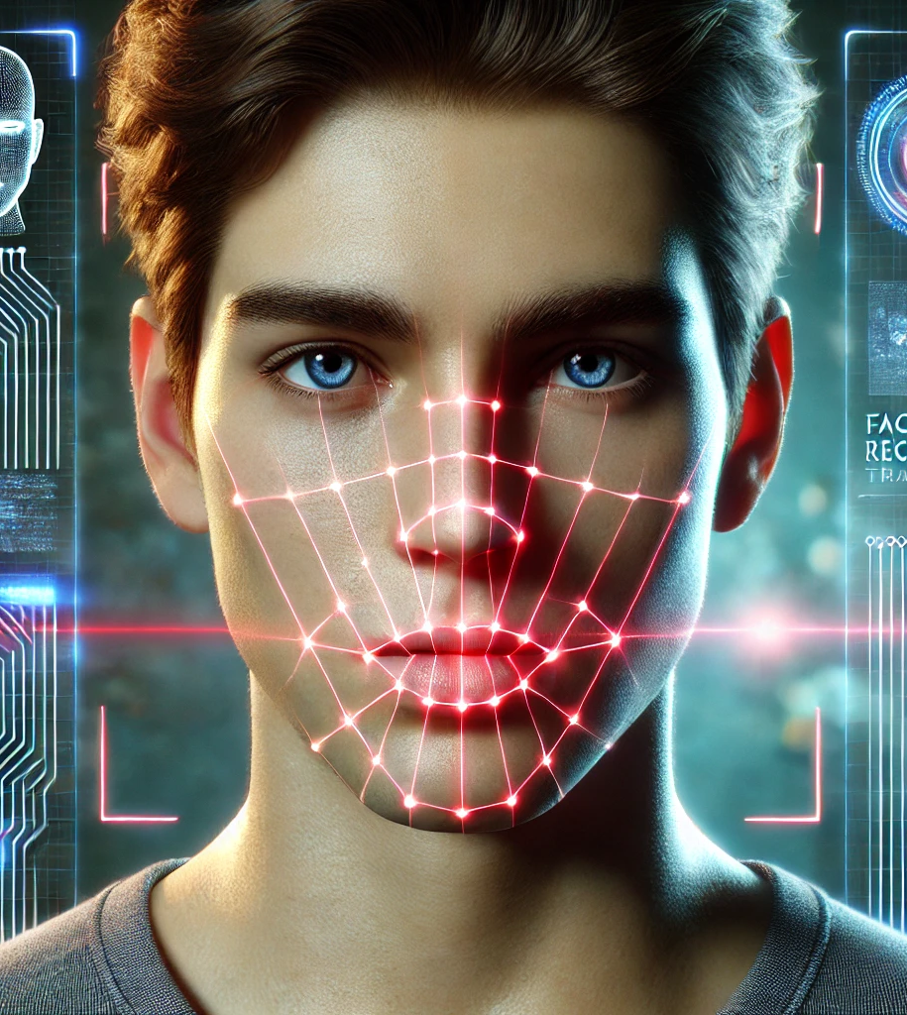
Viso Speak
Students : Majd Salameh, Morad Asakli
Supervisor : Ilya Zeldner

Slide 2
The Idea Behind VisoSpeak
VisoSpeak is a deep learning tool that helps with lip reading using only visuals.
Regular speech recognition doesn't work well in noisy places or when there's no sound.
many models are tied to specific languages.
VisoSpeak fixes these issues by focusing only on lip movements, making it more private and accessible.
Notes:
VisoSpeak is a deep learning tool that helps with lip reading using only visuals. Regular speech recognition doesn't work well in noisy places or when there's no sound. Also, many models are tied to specific languages. VisoSpeak fixes these issues by focusing only on lip movements, making it more private and accessible. Our project is built upon improving an existing lip-reading model from 2020, which had strong potential but needed enhancements. We refined its approach by making it more accurate and adaptable to different speaking styles

Slide 3
Exploring Existing Projects
LipNet (2016) - Works end-to-end but struggles with accuracy.
Lip Reading Sentences in the Wild (2017) - Uses both audio and video.
Lip Reading Sentences Using Deep Learning (2020) - Focuses on visual cues but uses fixed timestamps.
Notes:
We explored several existing projects in lip reading and identified three key models that have shaped this field.
LipNet (2016) – First end-to-end model, but low accuracy.
Lip Reading Sentences in the Wild (2017) – Uses audio and video, not purely visual.
Lip Reading Sentences Using Deep Learning (2020) – Fully visual but relies on fixed timestamps.
Each of these projects contributed valuable advancements, but they also had limitations.
We focused on the third model because it uses viseme classification, which makes it more flexible and adaptable for visual-only speech recognition

Slide 4
The Project We Chose
We chose the 2020 lip-reading system.
It uses viseme classification for better accuracy.
Its weakness : relies on Static Timestamps
Fixing this improves functionality and accuracy.
Notes:
The project we chose to improve is the 2020 lip-reading system. We selected this model because it utilizes viseme classification, which makes it more flexible and adaptable for recognizing speech through visual cues. However, we identified a key weakness: it relies on static timestamps to segment speech, which limits its accuracy and adaptability.
By replacing static timestamps with dynamic timestamps, we can make the system more responsive to different speaking speeds and improve overall accuracy. This enhancement makes the model more effective in real-world scenarios where speech patterns vary

Slide 5

Limitations of the Previous Approach
Uses fixed timestamps for detecting word boundaries.
Relies on a predefined time structure.
Struggles with different speaking speeds.
Weakness: Static timestamps limit adaptability to different speaking speeds.
Notes:
The old algorithm used fixed timestamps to detect word boundaries, meaning it followed a rigid timing structure that did not adjust based on the speaker’s natural pace. This caused errors, especially when people spoke too fast or too slow.
Because the algorithm did not adapt to different speaking speeds, it often incorrectly segmented words, reducing its accuracy. This limitation made it less reliable in real-world scenarios

Slide 6

How We Improved the Approach
Replaced fixed timestamps with dynamic timestamps.
Added 8 variables to calculate average time between words and letters.
Achieves better accuracy in detecting word boundaries.
Adapts to different speaking speeds.
Notes:
One of the biggest weaknesses of the previous approach was its reliance on fixed timestamps, which did not adjust to different speaking speeds. To solve this, we replaced them with dynamic timestamps, allowing the system to adapt in real-time to the speaker’s pace.
To improve word boundary detection, we introduced 8 new variables that help calculate the average time between words and letters for each user. This personalized approach ensures better segmentation and higher accuracy, making the system more effective in real-world scenarios.

Slide 7

The 8 Key Variables
8 variables help calculate the average time between words and letters:
  SBL - Space Between Letters
  SBW - Space Between Words
  NOL - Number of Letters
  NOW - Number of Words
  SOTTL - Sum of Time for Letters
  SOTTW - Sum of Time for Words
  avg_time_letter - Average Letter Time
  avg_time_word - Average Word Time
Notes:
To make our system more adaptive and accurate, we introduced 8 key variables that measure different aspects of speech timing.
SBL & SBW track the spacing between letters and words, helping the system understand how users naturally pause while speaking.
NOL & NOW count the number of letters and words, providing a structure for segmentation.
SOTTL & SOTTW calculate the total time spent on letters and words, which helps in refining timestamps dynamically.
avg_time_letter & avg_time_word give an average duration for each user’s speech, allowing the model to adapt its timing based on individual speaking patterns.
By using these variables, our system can adjust dynamically to each speaker, achieving higher accuracy in detecting word boundaries and making lip reading more precise.

Slide 8

Impact of Our Improvements
More accurate lip reading.
Works better in real situations.
Adapts to different speaking styles.
Notes:
With dynamic timestamps, our model is more accurate and works better in real life. It detects words more clearly and reduces mistakes. This improvement makes lip reading more helpful for assistive tools, silent communication, and speech recognition.

Slide 9

Algorithm & Process Workflow

Slide 10
Full Process Flow Overview
Video Upload
Video
Upload
Face
Detection
Lip
Detection
Preprocessing
Feature
Extraction
O(1)
Output
Sentence
Reconstruction
Viseme Classification
Simple I/O operation
Notes:
we see the full process flow of our system. The flow begins with the video upload and progresses through each stage until we reach the final output. Let’s now break down each step and explain how the algorithms work in detail.
The first step in the process is simply uploading the video. This is the starting point, where the user provides the video file in MP4 format. There's no complex algorithm involved here; it's just an I/O operation to upload the file. The time complexity here is O(1), as it’s independent of the video size.

Slide 11
Full Process Flow Overview
Face Detection
Video
Upload
Face
Detection
Lip
Detection
Preprocessing
Feature
Extraction
O(1)
O(n*m)
Output
Sentence
Reconstruction
Viseme Classification
Algorithm: SSD (Single Shot MultiBox Detector)
Notes:
The second step is face detection. We use the Single Shot MultiBox Detector (SSD) algorithm, a deep learning-based model that detects faces within the video frames. SSD is efficient and fast, and it works by sliding over the image at different scales. The time complexity for face detection is O(n * m), where n is the number of frames and m is the number of pixels in each frame.

Slide 12
Full Process Flow Overview
Lip Detection
Video
Upload
Face
Detection
Lip
Detection
Preprocessing
Feature
Extraction
O(1)
O(n*m)
O(n*m*d)
Output
Sentence
Reconstruction
Viseme Classification
Algorithm: CNN (Convolutional Neural Network)
Notes:
After detecting the face, the next step is lip detection. We focus on identifying the lip region in the video. This is done using a CNN (Convolutional Neural Network), a deep learning technique that helps us identify key facial landmarks. The time complexity for lip detection is O(n * m * d), where d is the number of landmarks detected, and this step ensures that we focus only on the lips for further analysis."

Slide 13
Full Process Flow Overview
Preprocessing Frames
Video
Upload
Face
Detection
Lip
Detection
Preprocessing
Feature
Extraction
O(1)
O(n*m)
O(n*m*d)
O(n*m)
Output
Sentence
Reconstruction
Viseme Classification
Convert, Normalize & Crop
Notes:
Now that we’ve detected the lips, we preprocess the frames. This involves converting the video frames to grayscale, normalizing pixel values, and cropping to focus on the lip region. This preprocessing step ensures that the model can focus on the relevant parts of the video, reducing noise and improving accuracy. The time complexity is O(n * m), where n is the number of frames and m is the number of pixels per frame.

Slide 14
Full Process Flow Overview
Feature Extraction
O(n*m*f*k)+
O(n*m*d)
Video
Upload
Face
Detection
Lip
Detection
Preprocessing
Feature
Extraction
O(1)
O(n*m)
O(n*m*d)
O(n*m)
Output
Sentence
Reconstruction
Viseme Classification
Algorithm: 3D-CNN + 2D-ResNet
Notes:
The next step is feature extraction. We use 3D-CNN (3D Convolutional Neural Networks) to capture spatial and temporal features across consecutive frames. This allows the system to understand the movement and context over time. Additionally, we use 2D-ResNet, a deep network architecture, for dimensionality reduction. This reduces the complexity of the features while retaining important visual information. The time complexity for 3D-CNN is O(n * m * f * k), where f is the filter size and k is the number of filters. For ResNet, it's O(n * m * d), where d is the feature dimension.
We dynamically adjust the timing variables such as Space Between Letters (SBL) and Space Between Words (SBW) based on the speaking speed. If the speaker talks quickly, we compress the space between letters and words; if the speaker talks slowly, we expand those spaces. This allows the system to be more accurate when processing frames at different paces

Slide 15
Full Process Flow Overview
Viseme Classification
O(n*m*f*k)+
O(n*m*d)
Video
Upload
Face
Detection
Lip
Detection
Preprocessing
Feature
Extraction
O(1)
O(n*m)
O(n*m*d)
O(n*m)
Output
Sentence
Reconstruction
Viseme Classification
O(n*d*T)
Algorithm: Transformer-based encoder-decoder.
Notes:
Once the features are extracted, we move to viseme classification. Here, we use a Transformer model to process the features and classify them into visemes. Visemes are visual representations of phonemes, and the Transformer helps us understand the relationship between them over time. The time complexity of the Transformer model is O(n * d * T), where n is the number of frames, d is the feature dimension, and T is the number of layers in the model. The system classifies visemes using a Transformer model. The key improvement here is dynamic timing. For instance, the system dynamically adjusts the Space Between Letters (SBL) and Space Between Words (SBW) based on speaking speed. This allows the model to recognize faster or slower speech more accurately.

Slide 16
Full Process Flow Overview
Sentence Reconstruction
O(n*m*f*k)+
O(n*m*d)
Video
Upload
Face
Detection
Lip
Detection
Preprocessing
Feature
Extraction
O(1)
O(n*m)
O(n*m*d)
O(n*m)
Output
Sentence
Reconstruction
Viseme Classification
O(v*p)
O(n*d*T)
Algorithm: Beam Search with Perplexity Analysis.
Notes:
Now we come to sentence reconstruction. We use Beam Search, a search algorithm, to find the most likely sequence of words based on the visemes. Beam Search evaluates multiple possible sequences and selects the one with the highest probability, improving the overall accuracy of word and sentence detection. The time complexity for Beam Search is O(v * p), where v is the vocabulary size and p is the number of possible word combinations.

Slide 17
Full Process Flow Overview
Preprocessing Frames
O(n*m*f*k)+
O(n*m*d)
Video
Upload
Face
Detection
Lip
Detection
Preprocessing
Feature
Extraction
O(1)
O(n*m)
O(n*m*d)
O(n*m)
Output
Sentence
Reconstruction
Viseme Classification
O(1)
O(v*p)
O(n*d*T)
Desired Output
Notes:
Summary of time complexity

Slide 18
Summary
More accurate word boundary detection
Improved sentence reconstruction
Adapts to different speaking speeds
Enhances real-world performance

Slide 19
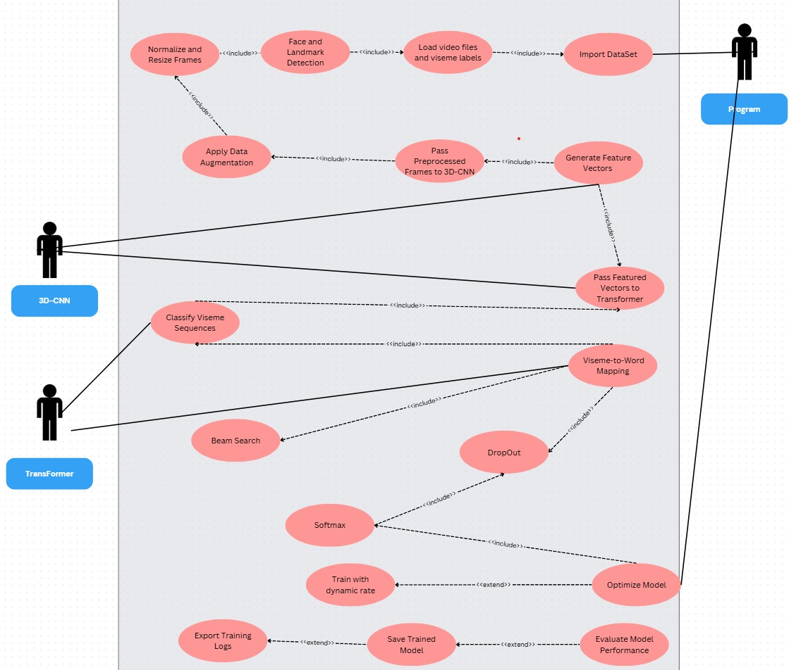
Training System Use Case
Notes:
This Training System Diagram outlines the workflow of training our lip-reading model. It illustrates how data moves through different components of the system.
Data Preparation:
The process starts with importing the dataset, which includes video files and viseme labels.
The frames are normalized and resized, and face and landmark detection is applied to focus on the lip region.
Data augmentation is then used to improve model generalization.
Feature Extraction:
Preprocessed frames are passed through a 3D-CNN, which extracts spatial and temporal features from the video.
These extracted features are then converted into feature vectors and passed to the Transformer for further processing.
Viseme Classification & Word Mapping:
The Transformer classifies viseme sequences and maps them to words.
Beam search is applied to refine sentence prediction.
Training Optimization:
The model undergoes training with a dynamic learning rate, improving adaptation to different datasets.
Dropout and Softmax layers are included to prevent overfitting and optimize classification.
Model Evaluation & Saving:
After training, the model is optimized, its performance is evaluated, and the trained model is saved.
Training logs are exported for further analysis.
This process ensures that our model is trained efficiently, making it more accurate, adaptable, and effective in real-world lip-reading applications

Slide 20
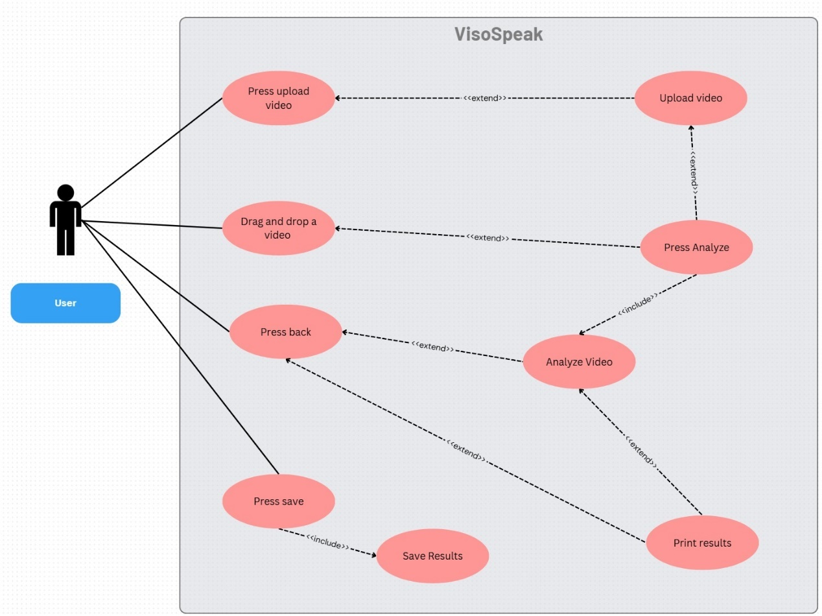
Use Case Diagram
Notes:
This Use Case Diagram represents the main interactions a user has with the VisoSpeak system.
The user can upload a video either by pressing the upload button or by dragging and dropping a file into the system.
Once the video is uploaded, the user can press the analyze button, which triggers the analyze video process.
After analysis, the system allows the user to print the results or save them for future reference.
There is also a back button that lets users navigate the interface smoothly.

Slide 21
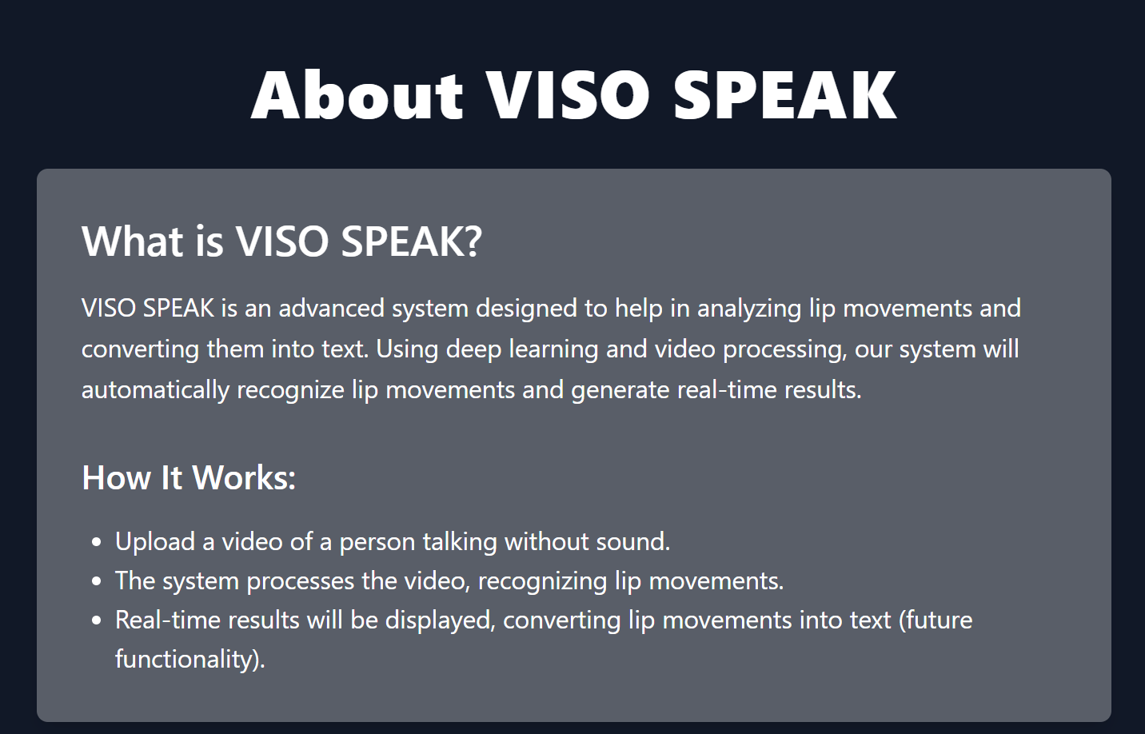
About Screen

Slide 22
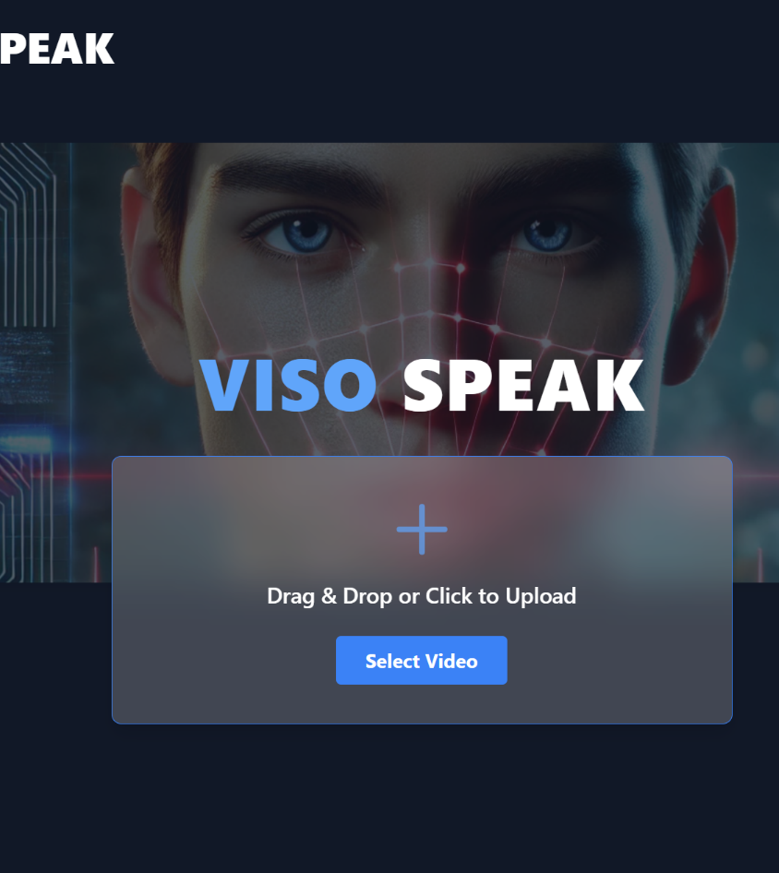
Home Screen

Slide 23
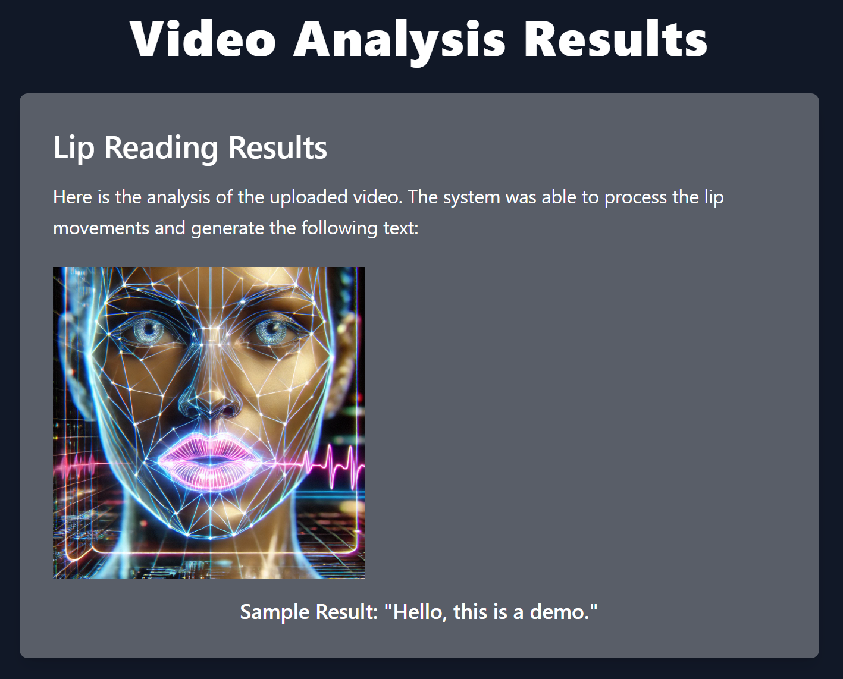
Result Screen

Slide 24
Summary
Key Achievements & Improvements
✅ More accurate word boundary detection
✅ Improved sentence reconstruction
✅ Adapts to different speaking speeds
✅ Enhances real-world performance
Time & Space Complexity
🕒 Time Complexity:
Face & Lip Detection, Preprocessing, Feature Extraction → O(n*m)
Viseme Classification & Sentence Reconstruction → Optimized for efficiency
💾 Space Complexity:
Preprocessed Frames & Feature Extraction → O(n*m)
Model Parameters & Output Storage → O(d*T) & O(v)
⚡ Efficiency:
Simple I/O operations prevent extra computational cost
Dynamic timing analysis improves accuracy without slowing performance

Slide 25

Thank you for listening

Slide 26
Refrences
[1] | A. S. O. V. A. Z. Joon Son Chung, "Lip Reading Sentences in the Wild," in IEEE Conference on Computer Vision and Pattern Recognition, 2017.
[2] | D. C. K. G. P. X. Souheil Fenghour, "Lip Reading Sentences Using Deep Learning With Only Visual Cues," 2020.
[3] | B. S. S. W. N. d. F. Yannis Assael, "LipNet: Sentence-Level Lipreading," 2016.
[4] | X. Z. S. R. J. S. Kaiming He, "Deep Residual Learning for Image Recognition," in IEEE Conference on Computer Vision and Pattern Recognition (CVPR), 2015.
[5] | W. X. M. Y. K. Y. Shuiwang Ji, "3D Convolutional Neural Networks for Human Action Recognition," in 27th International Conference on Machine Learning, 2010.
[6] | D. Y. Soonkyu Lee, "Audio-to-Visual Conversion Using Hidden Markov Models," in PRICAI 2002, LNAI 2417, 2002.
[7] | C. L. L. R. C. H. W. R. Sofia Lemons, " Beam Search: Faster and Monotonic," in 32nd International Conference on Automated Planning and Scheduling (ICAPS), 2022.
[8] | T. V. R. C. Clara Meister, "Best-First Beam Search," in Transactions of the Association for Computational Linguistics, 2020.
[9] | K. N. T. S. I. S. Alec Radford, " Improving Language Understanding by Generative Pre-Training," in OpenAI.
[10] | D. A. D. E. C. S. S. R. C.-Y. F. A. C. B. Wei Liu, "SSD: Single Shot MultiBox Detector," in Lecture Notes in Computer Science, 2016.

